Slide 1
Market Literacy, Practice Models & Strategic Positioning
Week 2: Designing Your Ideal Practice Model

Slide 2

Market Literacy
Starting a medical practice requires moving beyond traditional clinical care to adopt tech-enabled, consumer-centric strategies. Success is built on understanding market gaps, choosing a flexible practice model, and positioning your brand as a "health partner" rather than a service provider.

Slide 3
Market Literacy: Data-Driven Foundations
Market literacy involves using specific data to identify where your services are most needed.
Demographic & Gap Analysis: Use local population data to identify unmet needs. For example, in 2025, areas with aging populations (Baby Boomers) show high demand for chronic disease management, cardiology, and memory care.

Slide 4
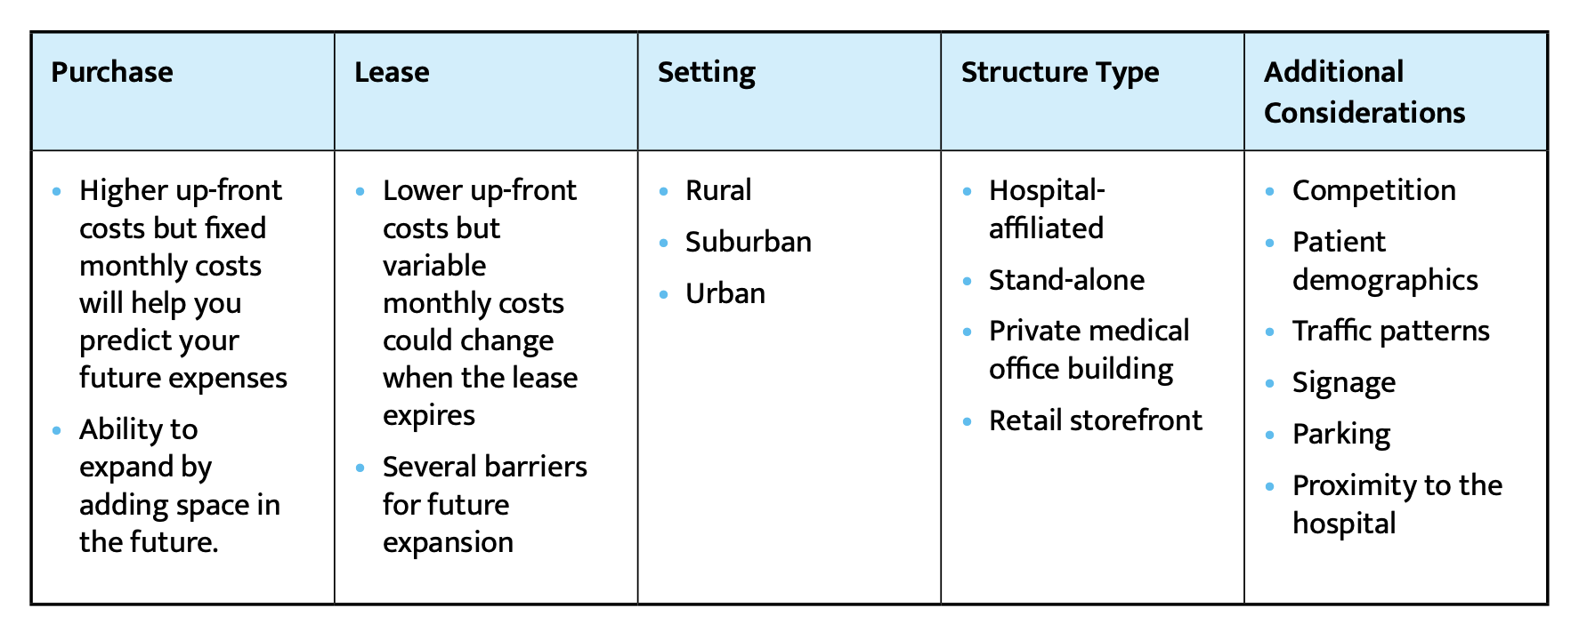
Market Literacy: Data-Driven Foundations
Location -Take stock of the local market and assess the needs of the population in that area. Determine whether buying or leasing property is best.
Factors to Consider when Choosing a Practice Location

Slide 5
Market Literacy: Data-Driven Foundations
In addition to demographic considerations, it’s important to consider Payer Mix and Competitor Saturation.
Payer Mix Assessment:
Understand the local insurance landscape (Medicare, Medicaid vs. private payers) to ensure your revenue cycle management (RCM) is aligned with local reimbursement rates.
Competitor Saturation:
Map existing practices within a 5–10 mile radius to identify "care deserts" or opportunities to offer specialized services (e.g., in-office procedures) that competitors lack.

Slide 6
Practice Model Overview
Practice models (or Care Models) take many forms such as: Solo practice, Group practice, DPC, Concierge, Hybrid, Micropractice
Care models have shifted from episodic, office-bound visits to continuous, tech-integrated systems.
Hybrid Care Delivery: Combine traditional on-site visits with Telehealth 2.0, which incorporates remote patient monitoring (RPM) and AI-powered diagnostic tools for 24/7 patient connectivity.
Precision & Personalized Medicine: Incorporate genomics or pharmacogenomics to tailor treatment plans based on individual genetic data, especially in specialties like oncology or endocrinology.
Value-Based Care (VBC): Align with models that reward preventative care and patient outcomes rather than just the volume of visits.
Multidisciplinary Teams: Use a holistic approach by integrating physician assistants (PAs), nurse practitioners (NPs), and virtual medical scribes to increase efficiency and reduce burnout.

Slide 7

Choosing a Practice Model
Choosing a Practice model depends on many factors that include:
Mission alignment
Patient population
Lifestyle goals
Revenue structure

Slide 8
Strategic Positioning
Differentiation
Value proposition
Service experience

Slide 9
Positioning: Becoming a "Health Partner"
Positioning is how you differentiate your practice in a competitive market.
Patient-Centric Value Proposition: Move toward a "hospitality-infused" model. Patients in 2025 act as consumers who value convenience—position your practice around easy online booking, mobile-optimized patient portals, and transparent billing.
Health Literacy Branding: Position your practice as an educator by using health literacy strategies (e.g., "universal precautions" where all info is assumed complex for patients) to ensure patients feel empowered and informed.
Digital Authority: Establish trust through "Social Proof." Claim your Google Business Profile for patient reviews and use video content (short-form interviews or clinic tours) to humanize your brand.
Strategic Partnerships: Differentiate through alliances. For instance, partnering with local gyms, wellness centers, or specialized tech companies can expand your reach and reinforce your role as a community health leader.

Slide 10
Example Practice Designs
Microclinic + tech stack
Executive concierge
Hybrid specialty clinic

Slide 11
Vision clarity leads to strategic execution. Your practice model is your foundation.

